Slide 1
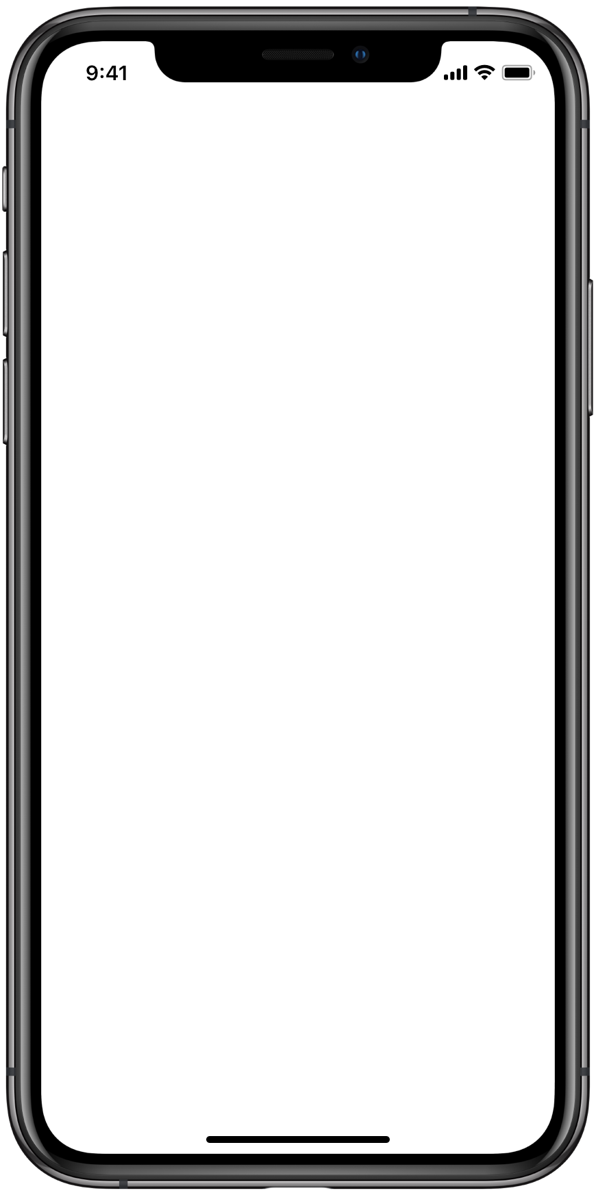
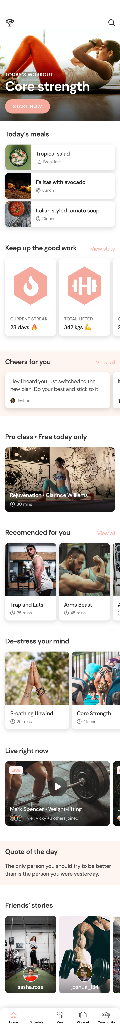

Workout & Health app
by Team Peak

Slide 3


Slide 4
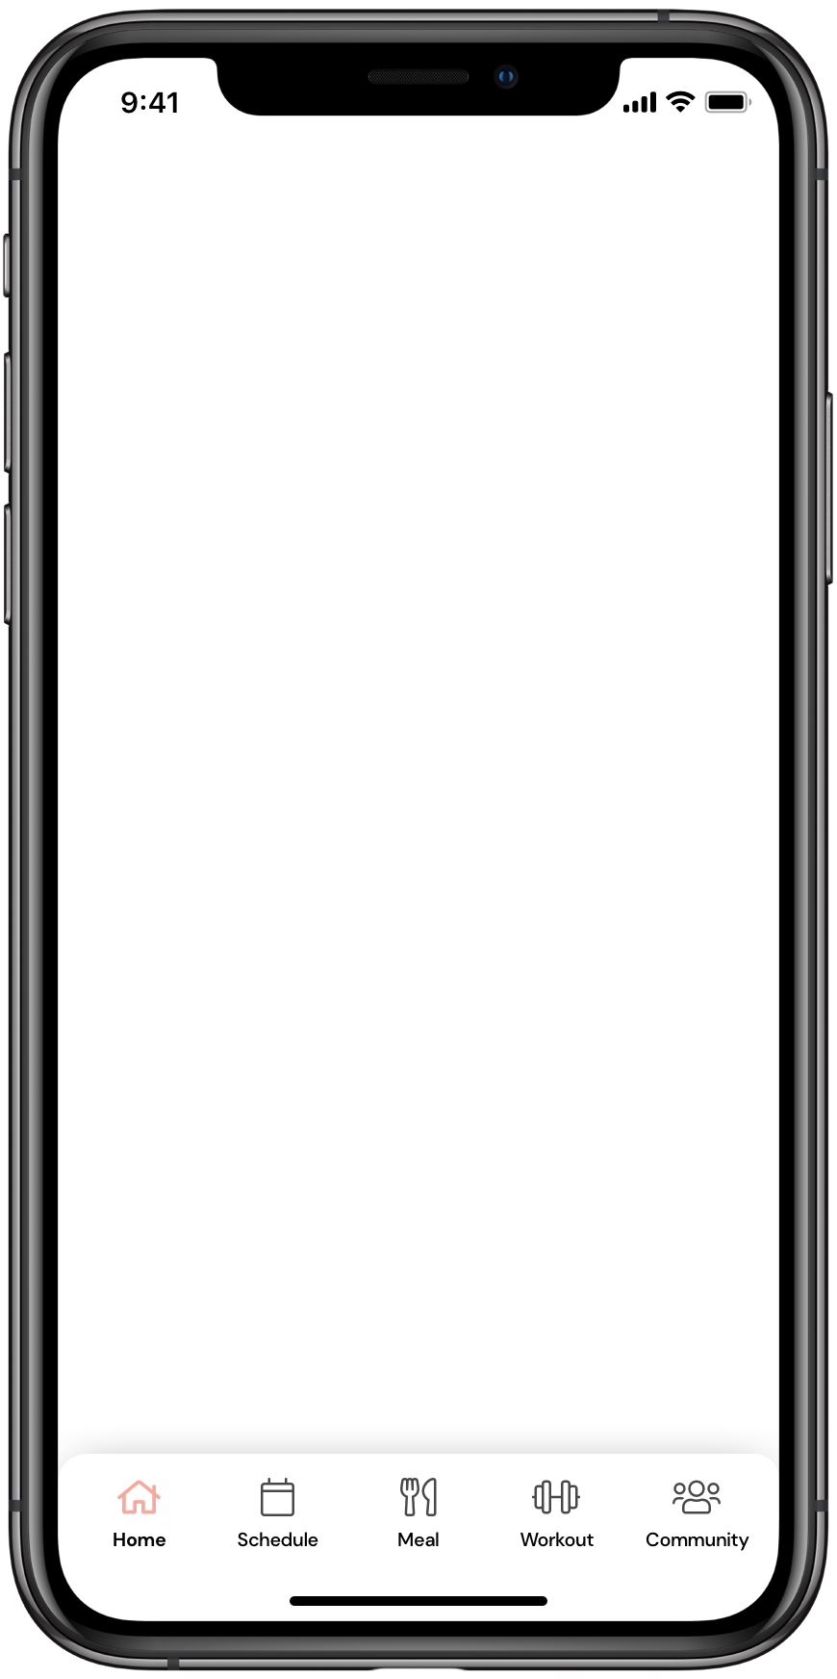

Slide 7
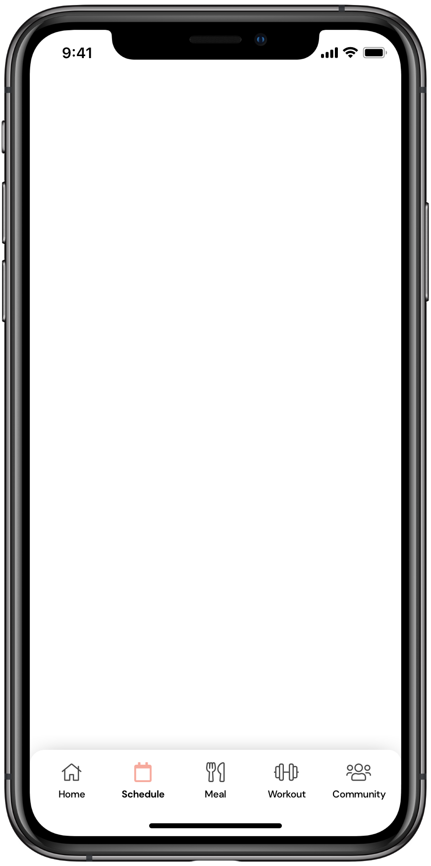
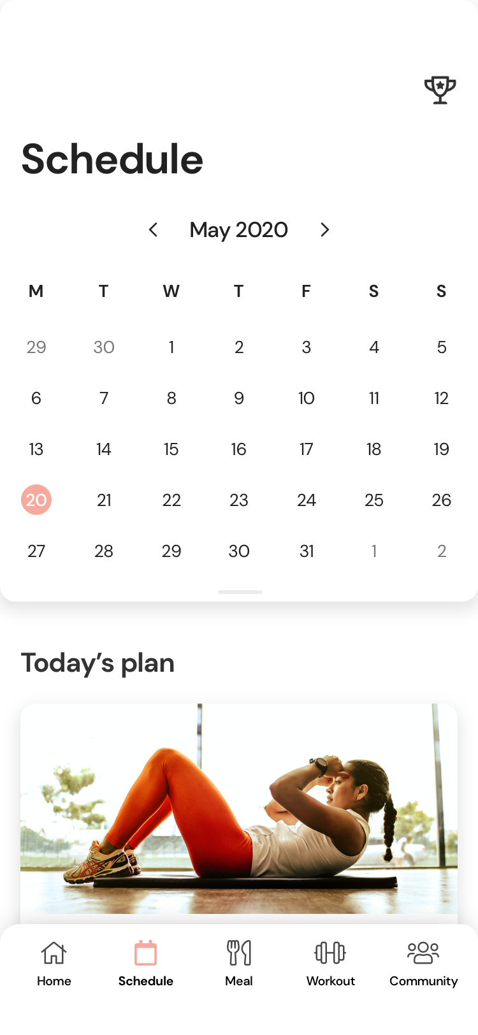
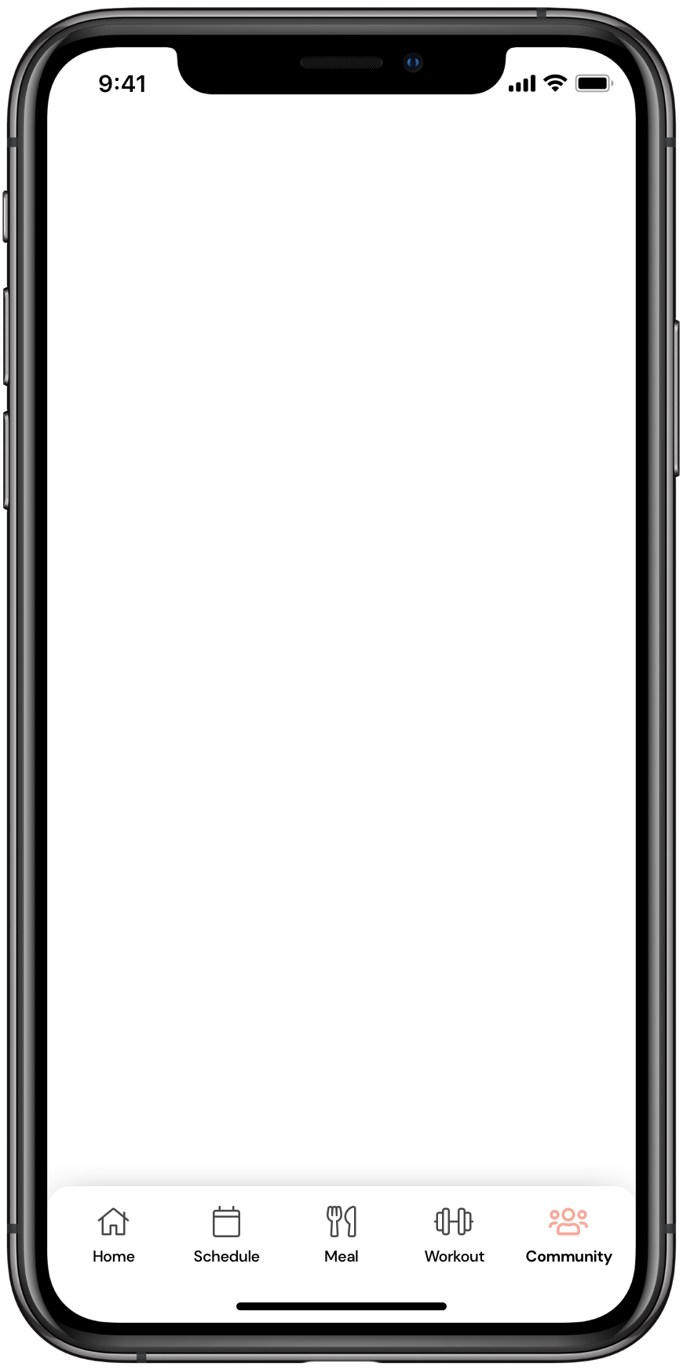
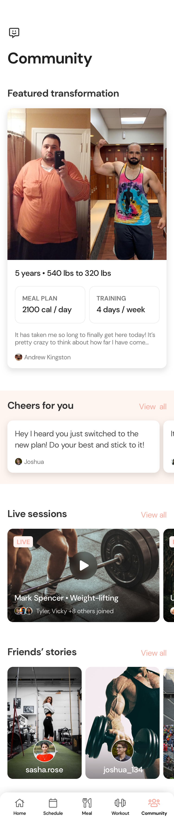
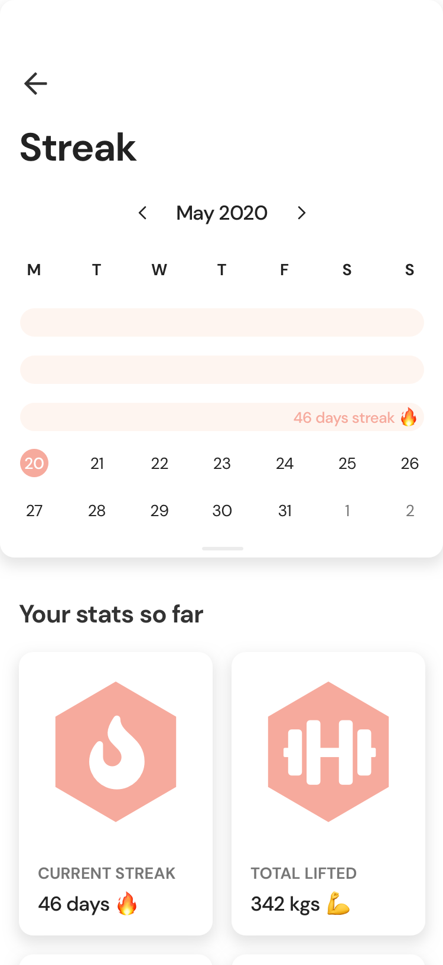
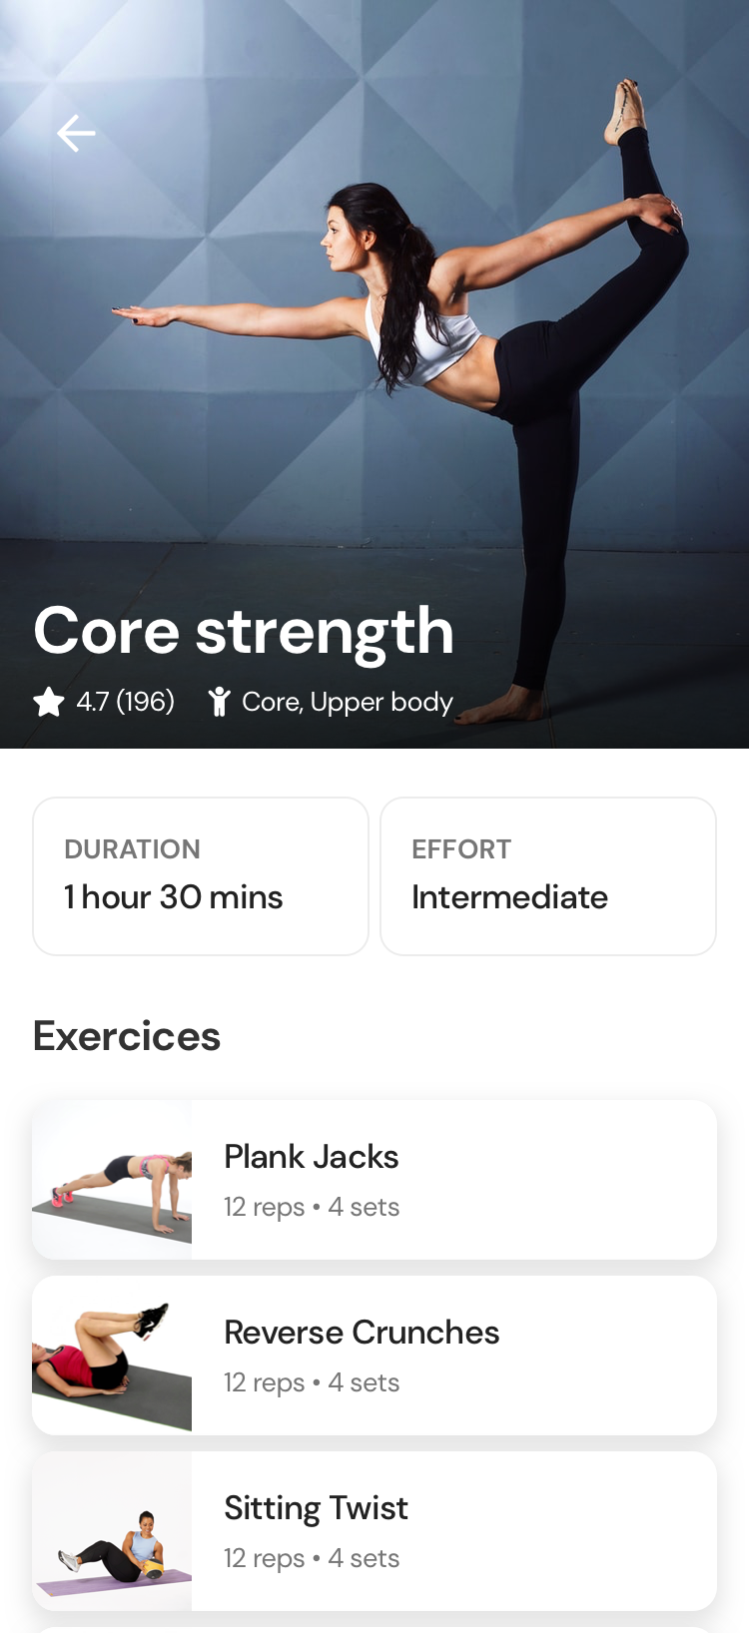
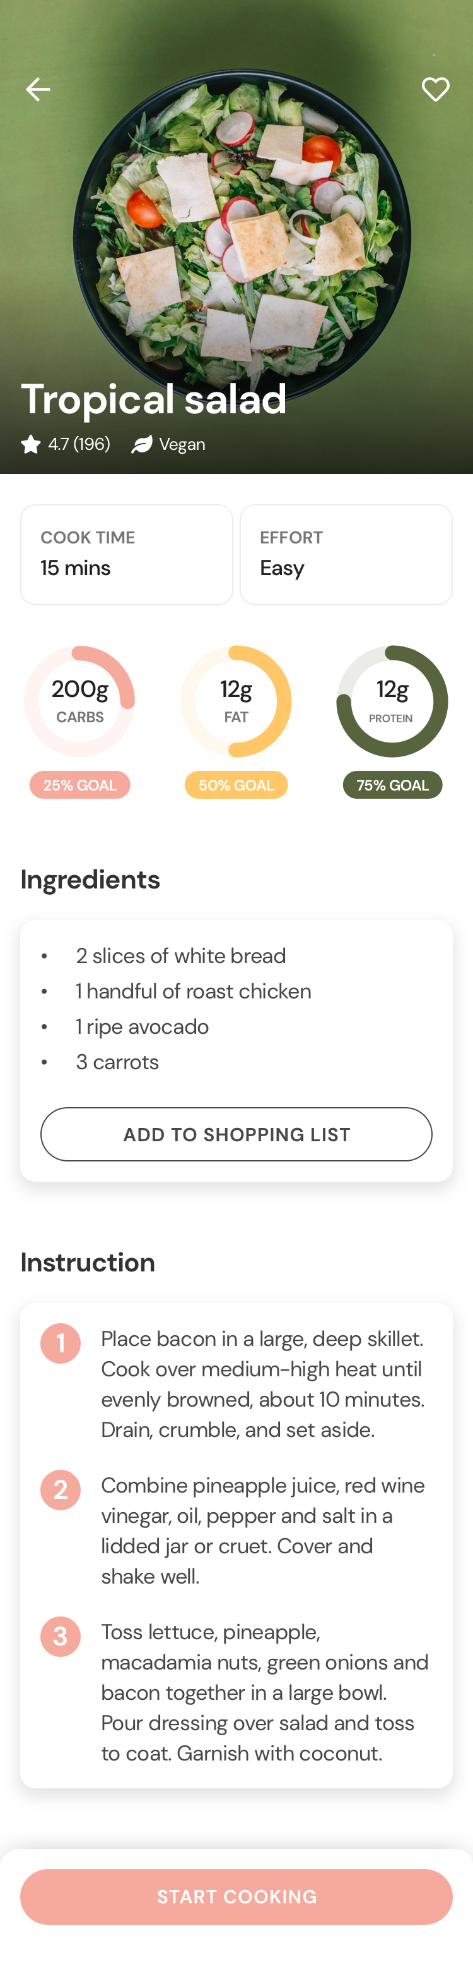
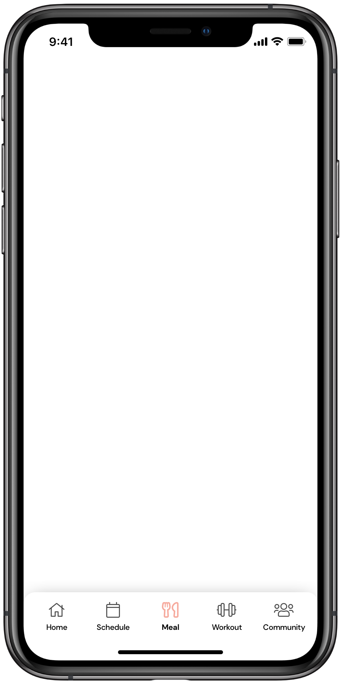
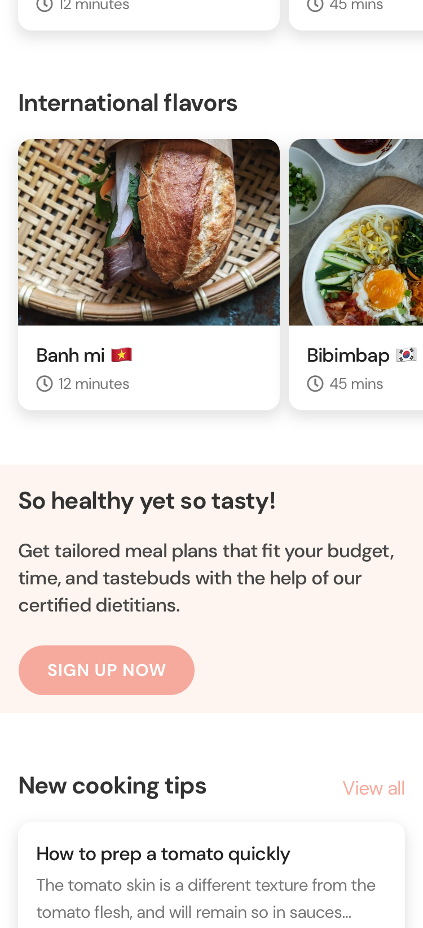
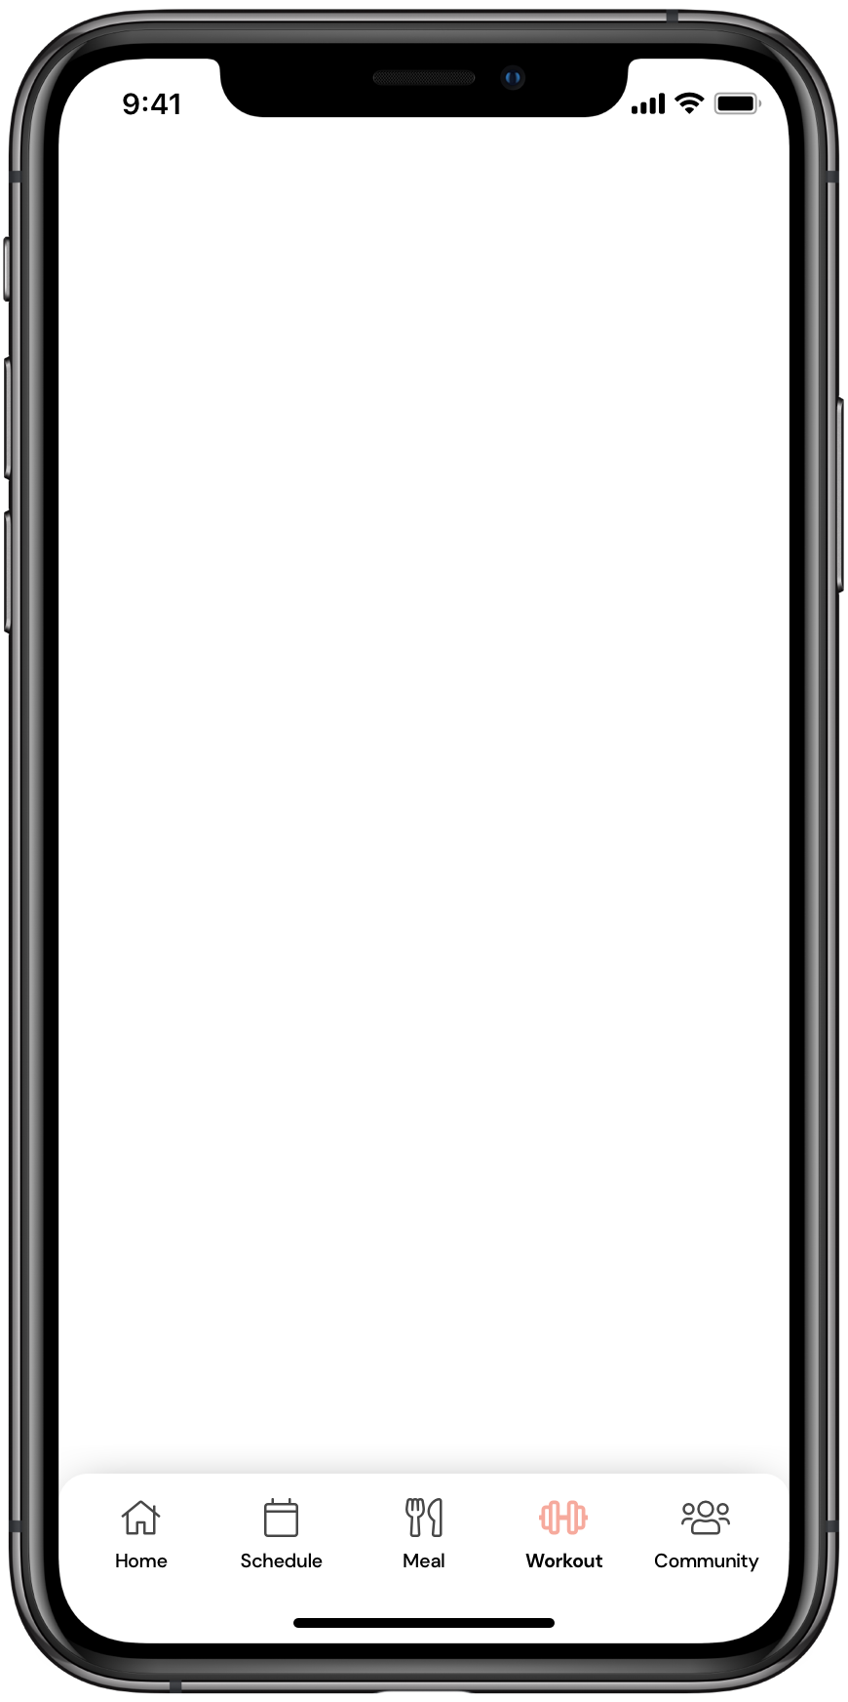
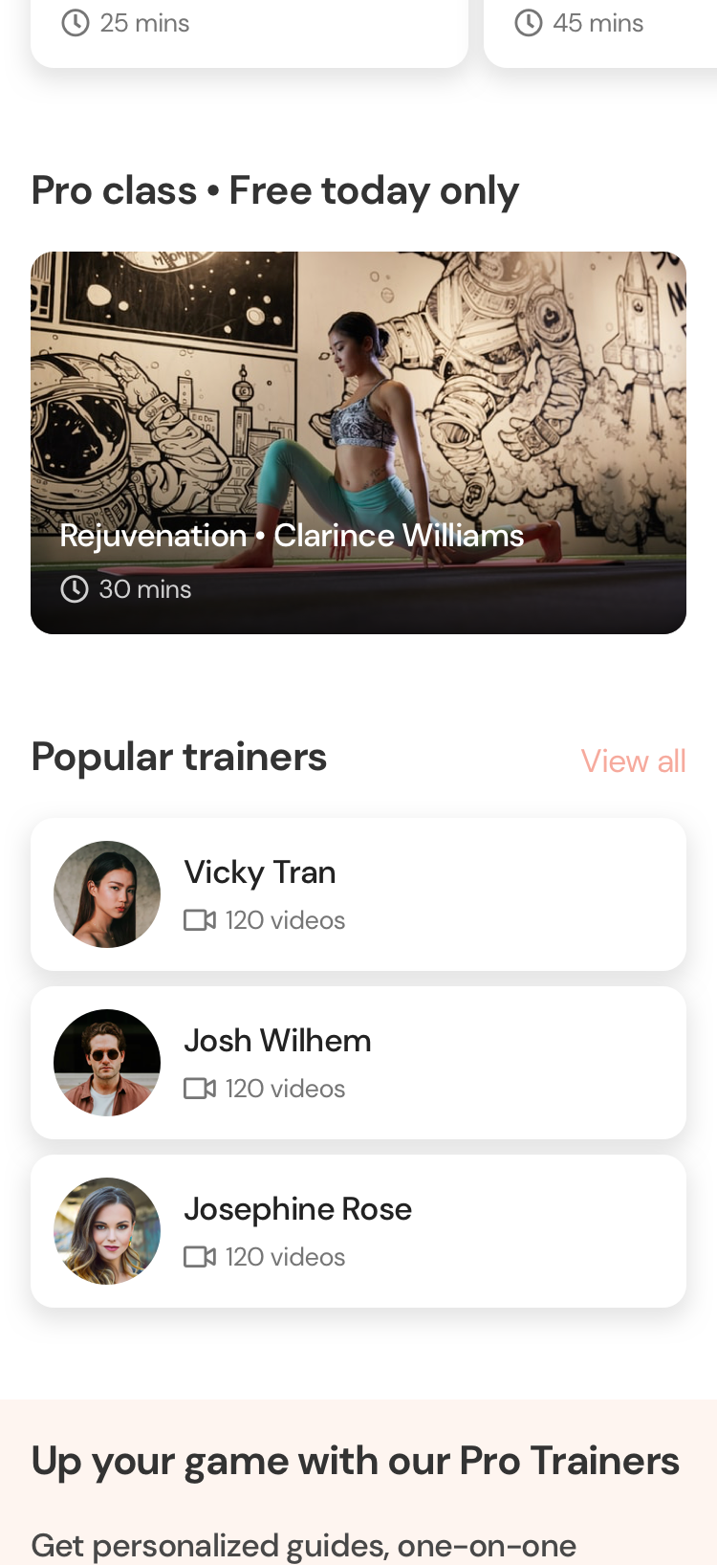

Slide 8
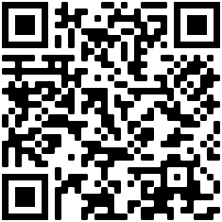
Try out Protein!
Scan the QR code
On iPhone X and newer, you can view the interface in full-screen by pressing the share button at the bottom, then “Add to Home Screen”

Slide 9
Description
Main Developer
Taesung Yoon S3847581

Slide 10
Friendly
Easy
Extensive

Slide 11
Market
[Position]
Jae Jun Kim S3741333

Slide 12
Innovation
Product Manager
Taehyeon Jeong S3799019

Slide 13
Design
UI/UX Designer
Quan Do S3800978

Slide 14
Friendly
Easy
Extensive

Slide 15
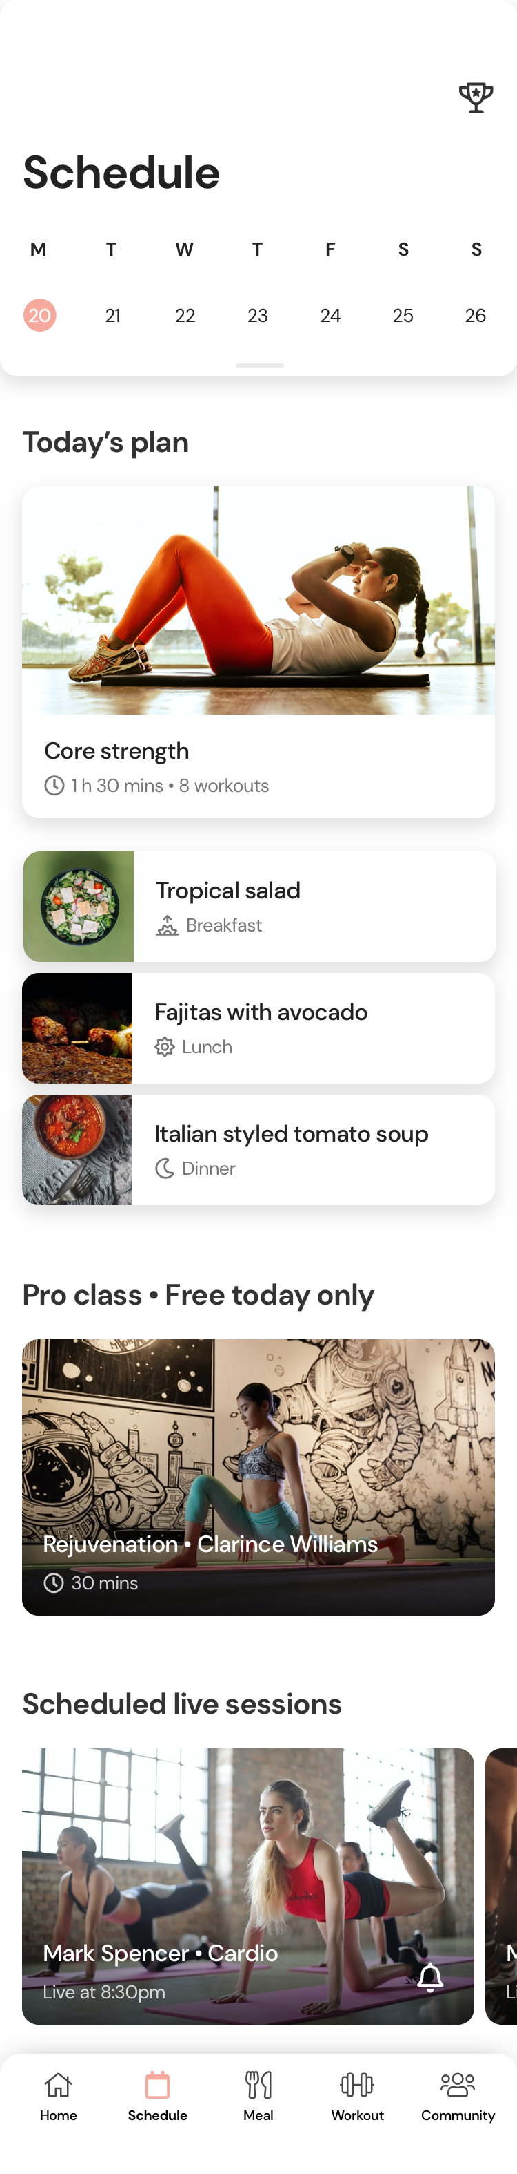

Slide 18
Header 5 • 17
Subtitle • 13

Slide 19
stats%
Description
Title
Body text

Slide 20
Color
#F6AA9D
Light
Approachable
Calming

Slide 21
Color
#F6AA9D
#FFC768
#58643D
#FEF5F0
#767676
#222222

Slide 22
Header 5 • 17
Subtitle • 13

Slide 23
Typeface
Header 1 • 41
CAPTION 15
Body • 17
CAPTION 13
Link • 17
Header 2 • 33
CAPTION 11
Subtitle • 13
Header 3 • 26
CAPTION 8
Header 4 • 21
Header 5 • 17

Slide 24
DM Sans
Typeface
Free for commercial use
Full web support
Friendly
Modern
Unique

Slide 25
DM Sans
Protein
Circular
Spotify
Cereal
AirBnb
Mark Pro
Mastercard
Google Sans
Google
San Francisco
Apple

Slide 26
Header 5 • 17
Subtitle • 13

Slide 27
Elevation
Large and high
Showcase content
Guide users where to click

Slide 28
Elevation
Large and high
Showcase content
Guide users where to click

Slide 29
Header 5 • 17
Subtitle • 13

Slide 30
Component
Consistency
Efficiency
Save time
Showcase brand

Slide 31
Component
Card / Image / Full width
Consistency
Efficiency
Save time
Showcase brand

Slide 32
Component
Consistency
Efficiency
Save time
Showcase brand

Slide 34
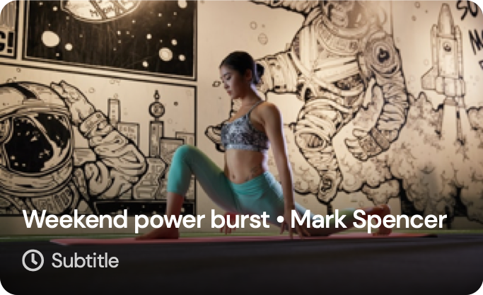
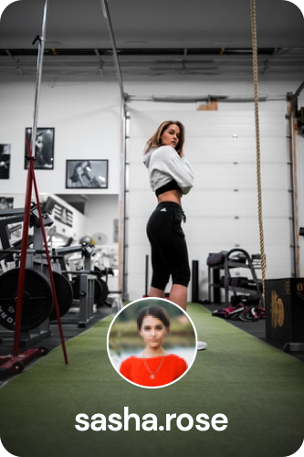
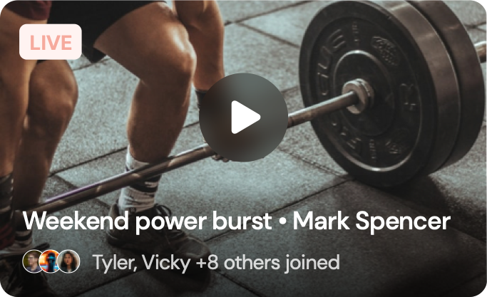

Slide 38
Thank you
for your attention
Team Peak
Taesung Yoon S3847581
Jae Jun Kim S3741333
Taehyeon Jeong S3799019
Quan Do S3800978

